Slide 1
Automation of NDT
In-Service: strategy & innovations
58th Annual A4A NDT Forum
Airlines for America
Alvaro ESPADA TEJEDOR
Airbus Operations

Slide 2


Content
Introduction
Eng NDT In-Service
NTM
NDT Methods
Strategy & Developments
Automation
Applications
NDT Technologies
Wrap-up
NDT Inspection

Slide 3
Engineering NDT In-Service Team
Engineering NDT In-Service Team is a transnational team located in 4 sites close to the Design Offices
Updated harmonized guidelines → Assimilation of NDT experience & lessons learnt of each member for team benefit
Updated NTM preparation process → from the Request for Feasibility study up to the clearance of “camera-ready” procedures
Main tasks
  NTM General & Specific Procedures development
  NDT for In-Service Technologies development
  NDT Contributor to Customer Services organization
(One of) Main challenge(s): knowledge management

Slide 4
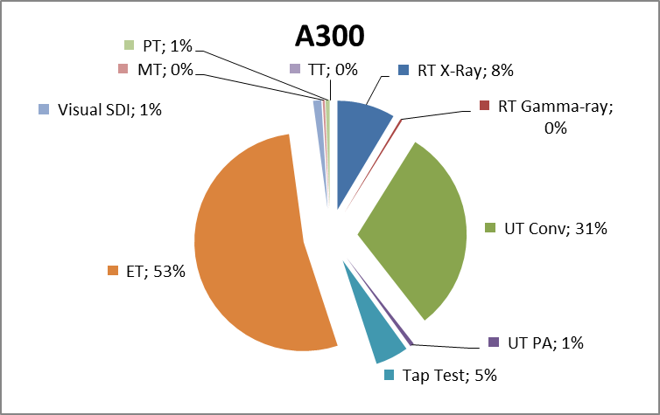
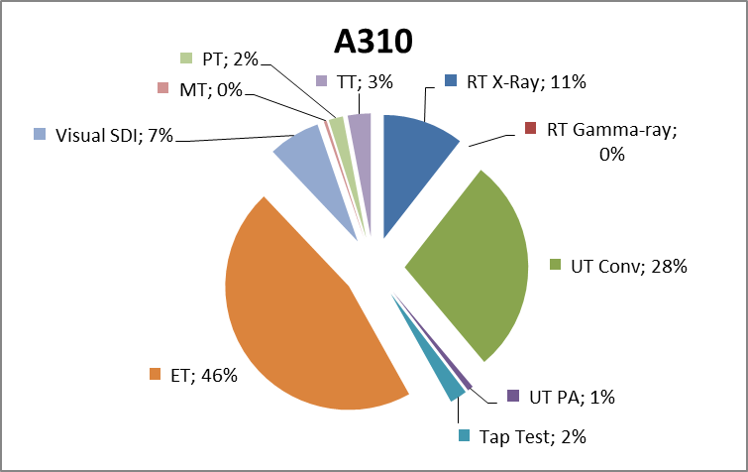
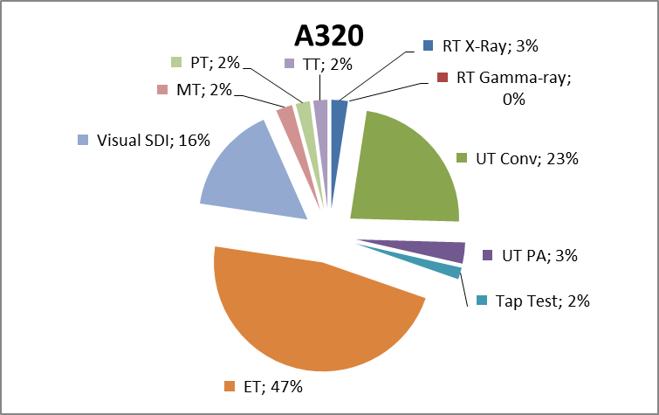
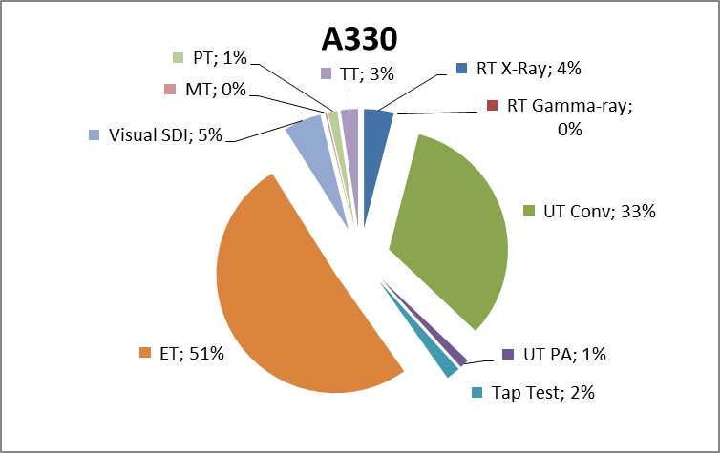
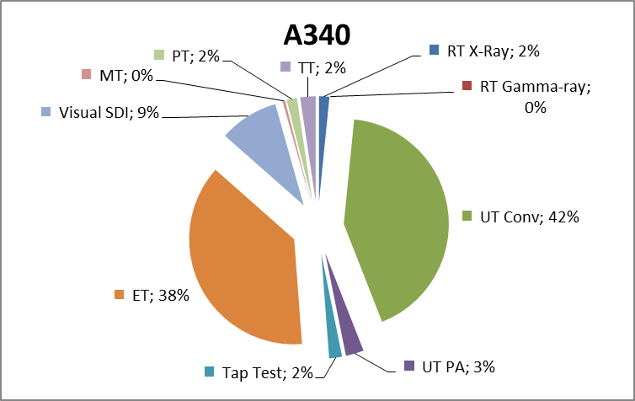
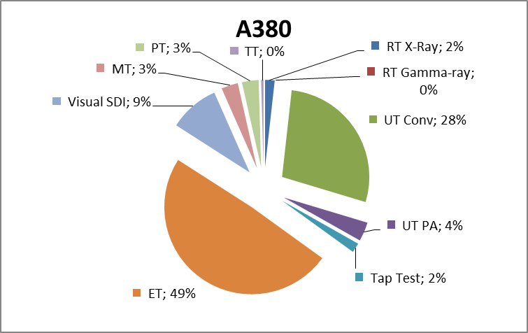
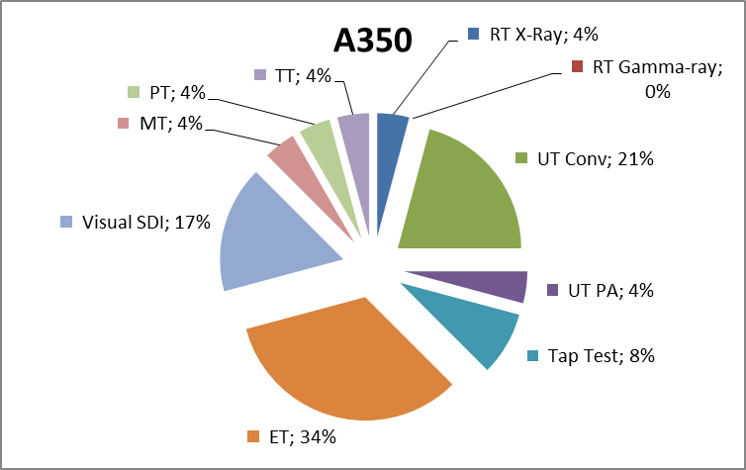
NDT Methods in Airbus NTM Manual
01/08/2015
In progress
Main NDT methods: Conventional ET & UT
Trend: growing PA UT & Visual SDI
LR & SA
Expected new procedures due to Extended Service Goal
Probable similar trend as of Nominal Service Goal
In progress
NOTE: All procedures, including general & specific procedures, alternative procedures and existing procedures for ESG and NEO variants

Slide 5
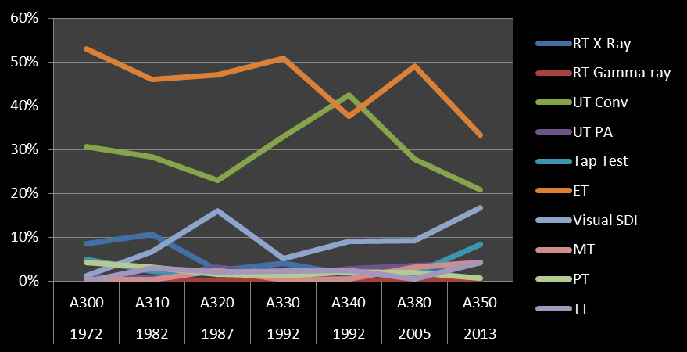
NDT Methods in Airbus NTM Manual
01/08/2015
In progress
Conventional ET & UT predominant methods in time till A380
Probable similar trend in A380 & A350 (NTM manual in progress)
NOTE: All procedures, including general & specific procedures, alternative procedures and existing procedures for ESG and NEO variants

Slide 6
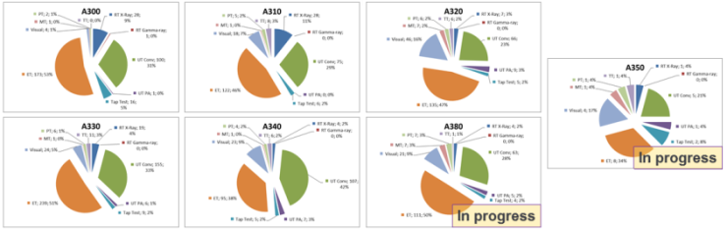
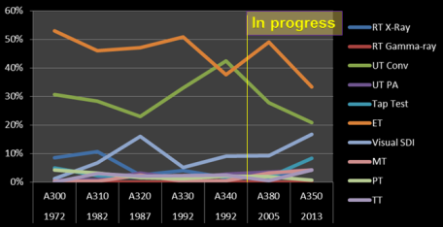
Strategy
Further develop conventional methods:
ET
UT
ET
UT
Develop & implement advanced technologies:
Visual
X-Ray (e.g. DDA)
Thermography
Explore and implement new applications:
AUTOMATION
Hardware & Software
Linetool family
Communication
Data management
Develop assisted NDT technologies:

Slide 7
NDT Automation
NDT AUTOMATION by AIRBUS
The use of methods for controlling NDT processes automatically, especially by electronically controlled systems, to allow NDT inspectors focusing on added-value tasks
Automation Software
Automation Hardware
NDT Inspectors
Collaboration
Time optimization
Knowledge management
Decision making
Focus on NDT

Slide 8

NDT Automation
SUPPLIERS
Instruments
Sensors
AIRBUS & SUPPLIERS
AUTOMATION
Instruments
Sensors
CONVENTIONAL NDT
Smart NDT Tools
ET
UT
ADVANCED NDT
UT Phased-Array
Wheelprobe
AIRBUS & SUPPLIERS
Digital Detector Arrays
Smart NDT Tools V2
Dolphicam
Linetool
ET Array
Cladtool
APPLICATIONS
Back-Scattering X-Ray
Denttool
Portable Tomography
Improved SRM Access
3D printed Tools
Data viewer/analyser
Automatic sizing
Online Maintenance Assistance
UT-excited Thermography
NOTE: Non-exhaustive list
Localisation of damages
SHM
AIRBUS & SUPPLIERS
Augmented reality applied to NDI
SOFTWARE

Slide 9
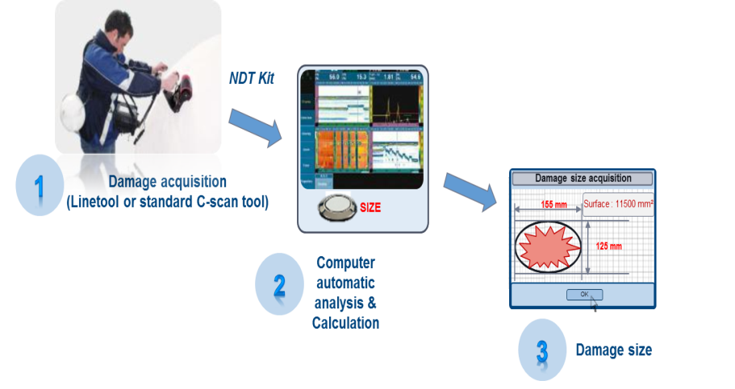
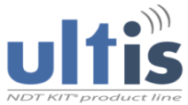
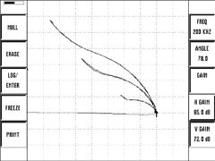
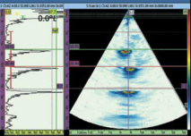

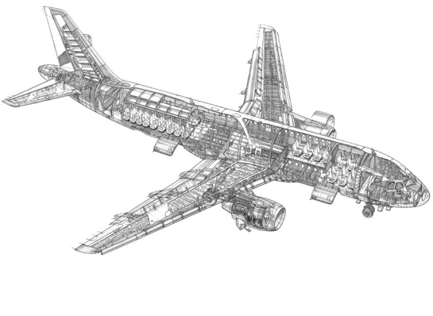
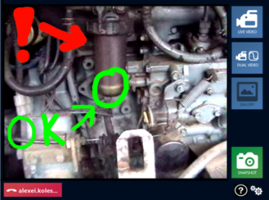
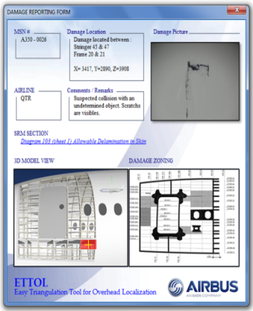


NDT Automation Hardware & Software
Data viewer/analyzer
Automatic sizing
Automatic
NDT Report
Inspect & Acquire data
Open with analyzer
Automatic sizing
Web browser based
Cross-platform (Inc. Android & iOS)
Real-time shared “write-on-screen”
Inspection area + instrument
Voice & video
Cross NDT method
NDT Expert
NDT Inspector
Operator
Structure Expert
Localisation of damages
Validate Ref 2
Validate Ref 1
Accurate location of damage on structure for further processing
Reference & triangulation of location

Slide 10
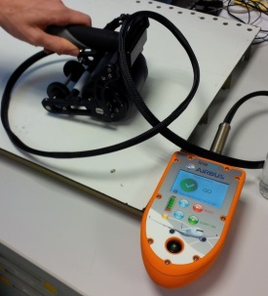
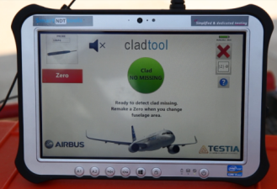
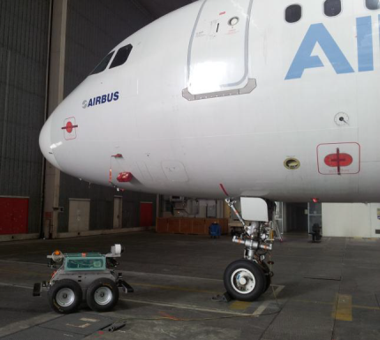
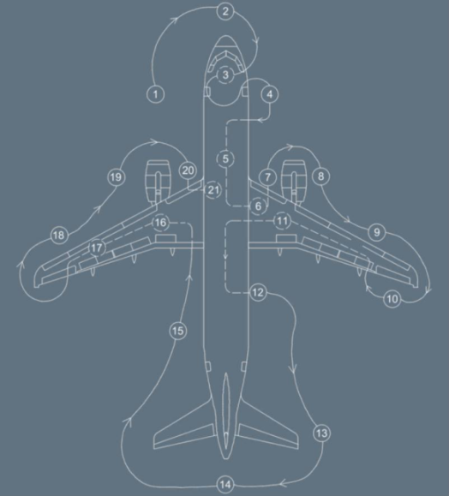
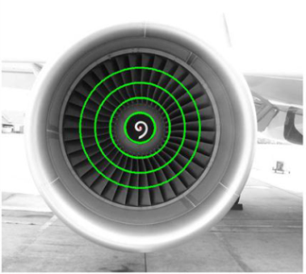
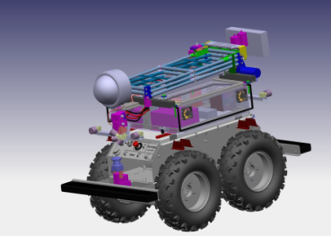
NDT Automation Hardware & Software
Linetool
Cladtool
Structural Health Monitoring
Impact Damage Detection
UT PA
Wheelprobe
Clad removal detection
Eddy current
Embedded Diagnosis
Scheduled SHM
Fast damage detection in daily common events
Damage detection in areas with scheduled inspection requirements and long/difficult accessibility tasks
AirCOBOT
Daily, transit / hangar visual inspections
Inspection traceability
Autonomous diagnosis
Reliability, repeatability and safety improvement
Faster visual inspection
Day & Night
Expandable

Slide 11
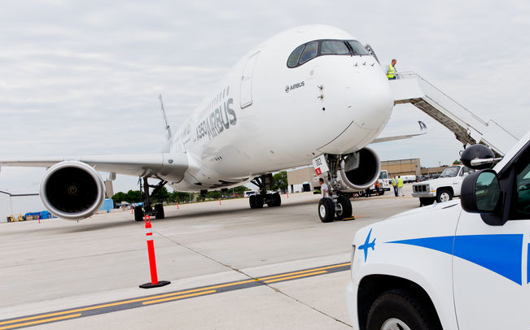





NDT Automation Scenarios
Airport “Look around”
Autonomous visual inspection of fuselage, wings, stabilizers and engines
Upper parts
VISUAL inspection
DroNDT
Automatic report
AirCOBOT
Lower parts
VISUAL INSPECTION
Ready for Flight

Slide 12




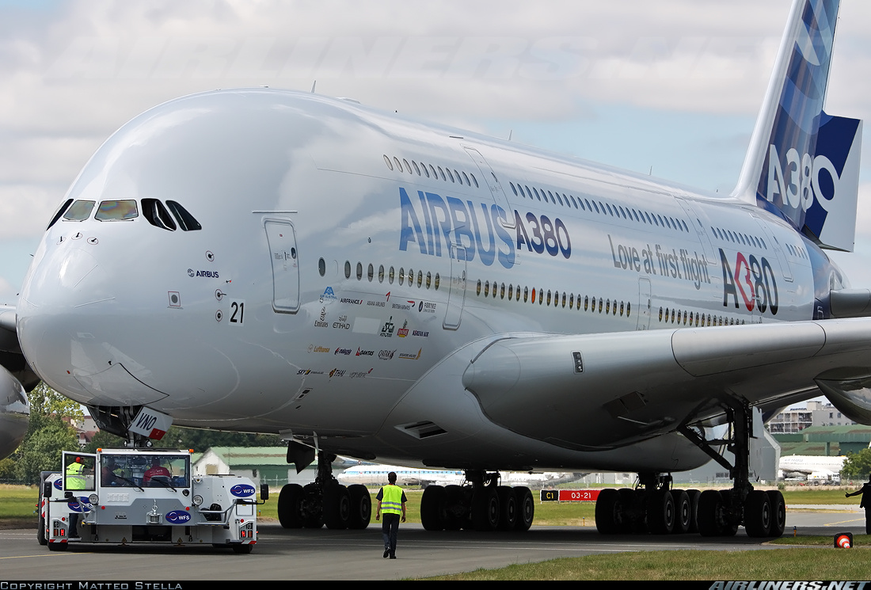

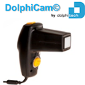



NDT Automation Scenarios
Doubts cleared by NDT Expert
NDT Report issued
Automatic localization
(Augmented Reality)
Airport “NDT”
e.g. AOG
Report ALL Info
(Augmented Reality)
Online SRM Access
Further NDT needed
Damage confirmed & sized
NDT Needed
Report with Finding
Ready for Flight

Slide 13
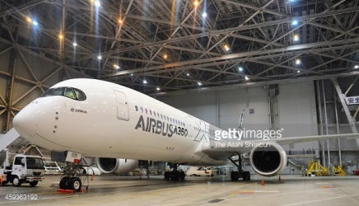
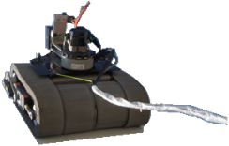
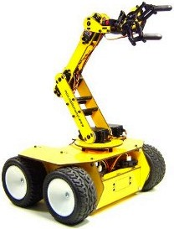
NDT Automation Scenarios
Scheduled NDT in Hangar (e.g. MRO)
e.g. distributed maintenance
Remote-controlled climbing / crawling robot with wireless HD video camera and exchangeable NDT electronics
Upper parts HD
visual inspection – Real time augmented reality
DroNDT
Crawler
Moving robot with wireless HD video camera and exchangeable NDT electronics
Moving robot

Slide 14
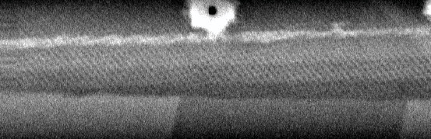
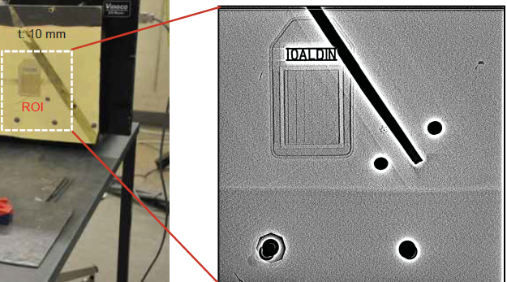
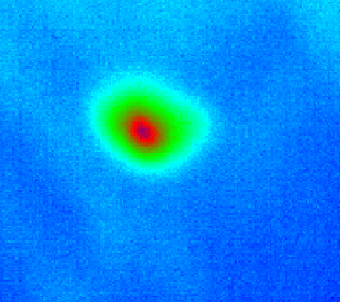
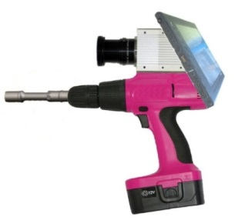
NDT Applications
One-side NDT Technologies
NDT of metal & composite structures
Outer & inner structures
Minimum radiation
Back-Scattering X-Ray
Portable Digital X-Ray
NDT of composite structures
Outer & inner structures
UT excited thermography
NDT of composite structures
Outer structures

Slide 15
Wrap-up
Simple use of advanced technologies: KEEP IT SIMPLE
Increase efficiency of inspectors: Focus skilled NDT inspectors on critical NDT steps
Increase data availability for maintenance follow-up / decision making
Adapt automation to each scenario & user
Contribute to A/C availability & Maintenance schedule management
Comply with requirements from Authorities
Comply with Operators needs

Slide 16

Q&A
Thank you for your attention
Airbus Engineering NDT In-Service

