Slide 1
Improvement of Aircraft Mechanical Damage Inspection with Advanced 3D Imaging Technologies
Mark Maizonnasse, Creaform

Slide 2
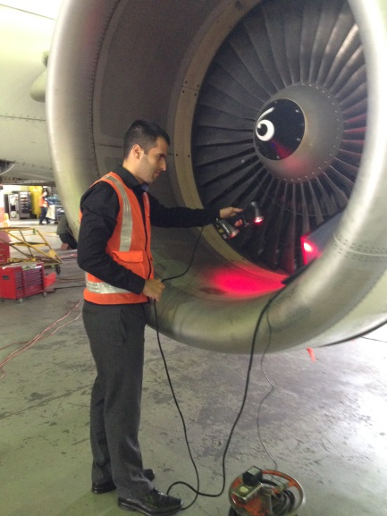
3D imaging technologies at the service of aircraft inspection
Needs in the industry:
Accurate and repeatable measurements
Reliable data
Portability/versatility
Speed for improved aircraft availability
How to automatize the inspection workflow?
Notes:
Zones critiques pour les mesures:
Reacteur
Sous l’avion (graviers qui rebondissent après les roues)
Au dessus de l’avion
Sur l’aile
Sur le bord d’attaque de l’aile
Dans le train d’atterissage

Slide 3
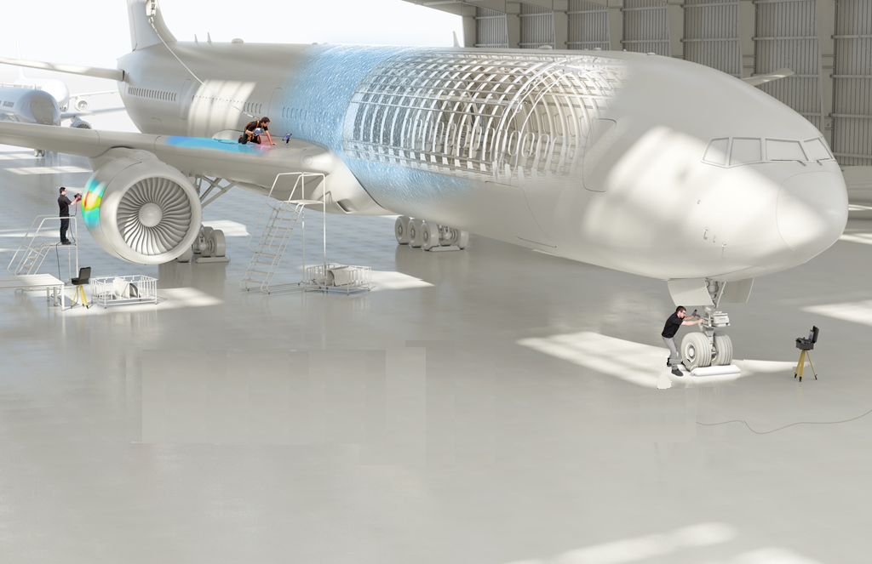
3D imaging around aircrafts
Notes:
Zones critiques pour les mesures:
Reacteur
Sous l’avion (graviers qui rebondissent après les roues)
Au dessus de l’avion
Sur l’aile
Sur le bord d’attaque de l’aile
Dans le train d’atterissage

Slide 4
Accuracy improvements with 3D Scanners

Slide 5
Truaccuracy technology embedded

Slide 6
TRUACCURACY*: Self-positioning device
*Unique to Creaform
Human factor controlled
Notes:
Enables users to position automatically all the different camera frames to one another
A minimum of 3 targets is used to position the scanner
Positioning through targets is the only method delivering metrology grade quality

Slide 7
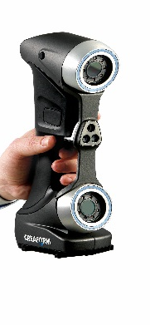
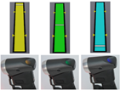
TRUACCURACY*: Self-positioning device
*Unique to Creaform
Optimal Stand-off distance / Live feedback
Intelligent acquisition method
Human factor controlled

Slide 8
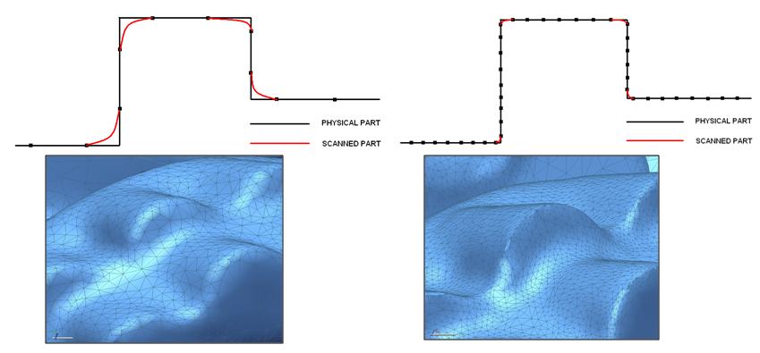
High Quality Results
Accuracy is independent of the user (30µm = 1.2 thou)
Resolution refers to the level of details that the sensor can acquire:
Set by inspector
Does not affect accuracy
Accuracy
Resolution
Notes:
Low resolution does not mean low accuracy. Low resolution will increase the speed of data acquisition. High resolution will be needed for detailed surface (lots of geometry elements) because more small triangles will be needed.
Usually, 1mm or 0.040 in is recommended for corroded pipes.

Slide 9
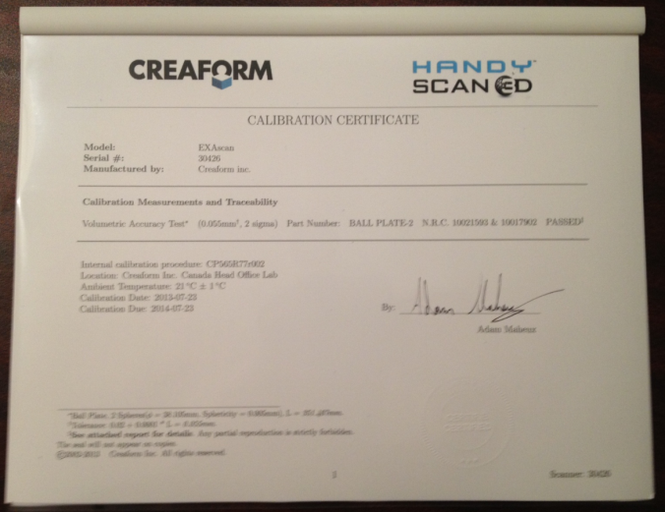
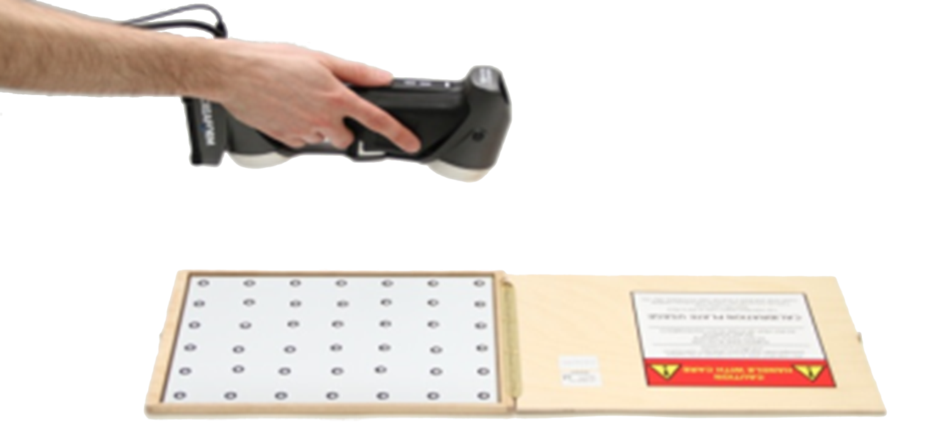
High Quality Results
On site calibration
Extra fast calibration +/- 30 secs
Traceability of calibration plate
Similar to calibration block with UT devices

Slide 10
Workflow and Software improvements

Slide 11
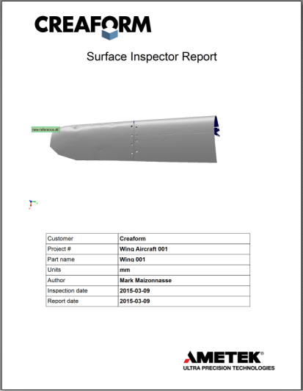
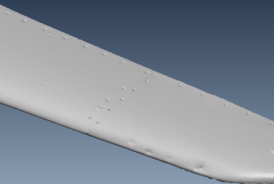
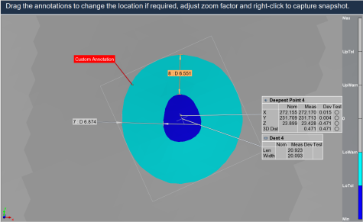
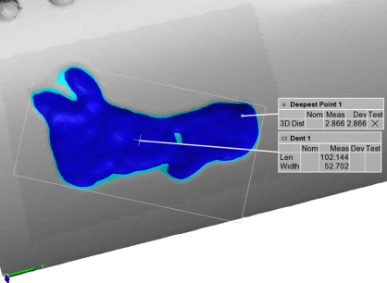
Simplest possible workflow
Surface acquisition (30 secs/m²)
Maximum depth, length, extraction and positioning(1-2 mins)
Reporting (seconds)

Slide 12
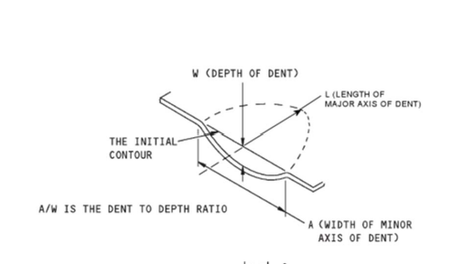
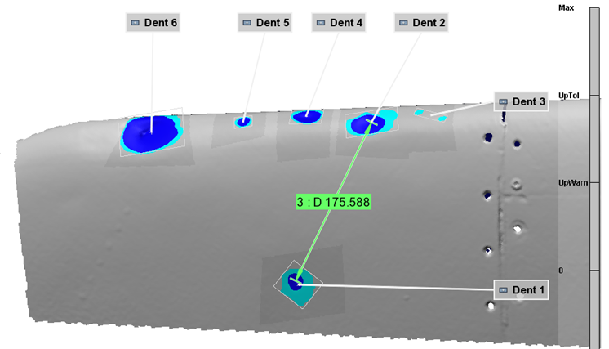
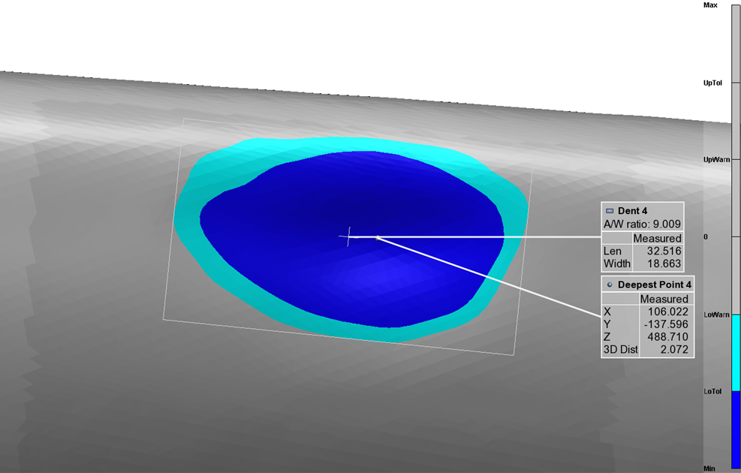
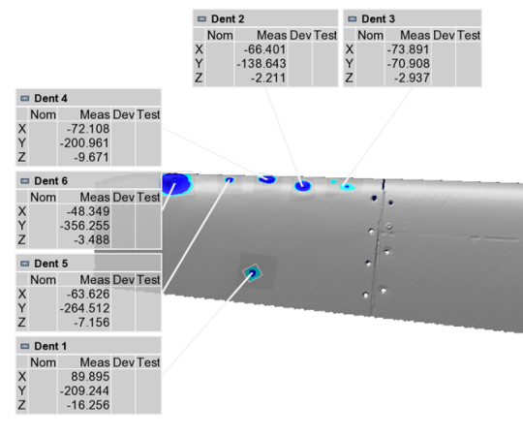
What Can be measured?

Slide 13
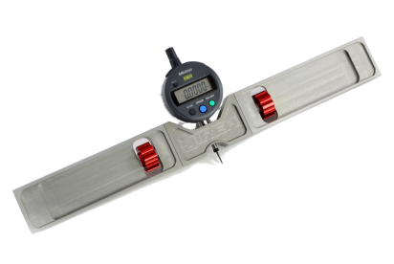
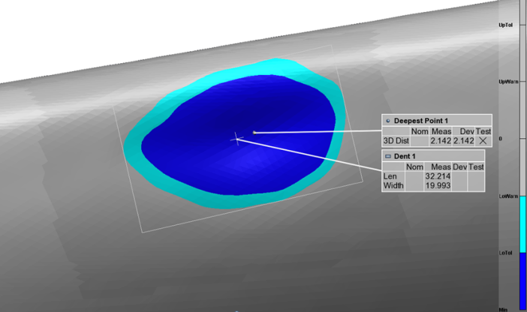
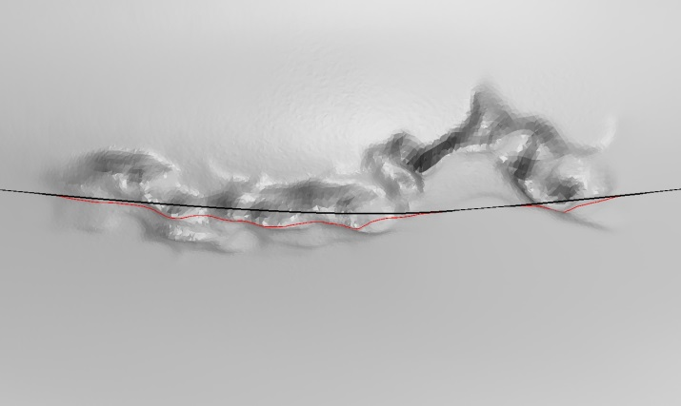
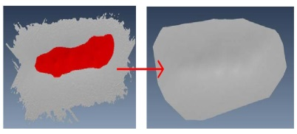
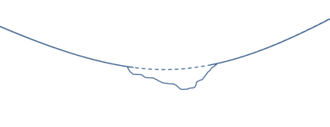
advanced capabilities
Reconstruction of reference surface based on the curvature around damaged area
Automatic extraction of deepest point and size of feature
Measurement possible on any surface/material
No limitations/error compared to pit gauge measurements

Slide 14
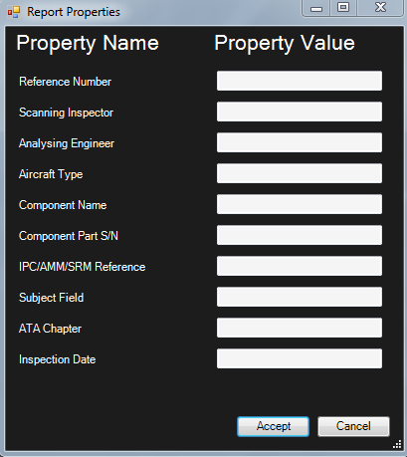
Editable Detailed Reports
The operator can fill all report properties shown in the report header.
A formatted report will be automatically generated.
PDF file or Excel export available
Custom report templates can be made for each customer

Slide 15
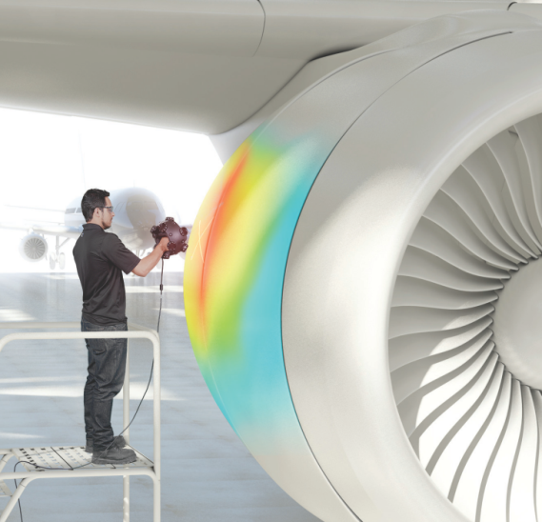
Summary of Major improvements
A simple inspection procedure:
4 clicks/dent
High accuracy and repeatable results, human factor controlled:
Up to 30µm
Automated report available in seconds:
Less than 1 min
Quick aircraft hail damage assessment: inspection time reduced by 80%
15mins/m² vs 4-5 hours manually

Slide 16
Live Demonstration

Slide 17
Other applications

Slide 18
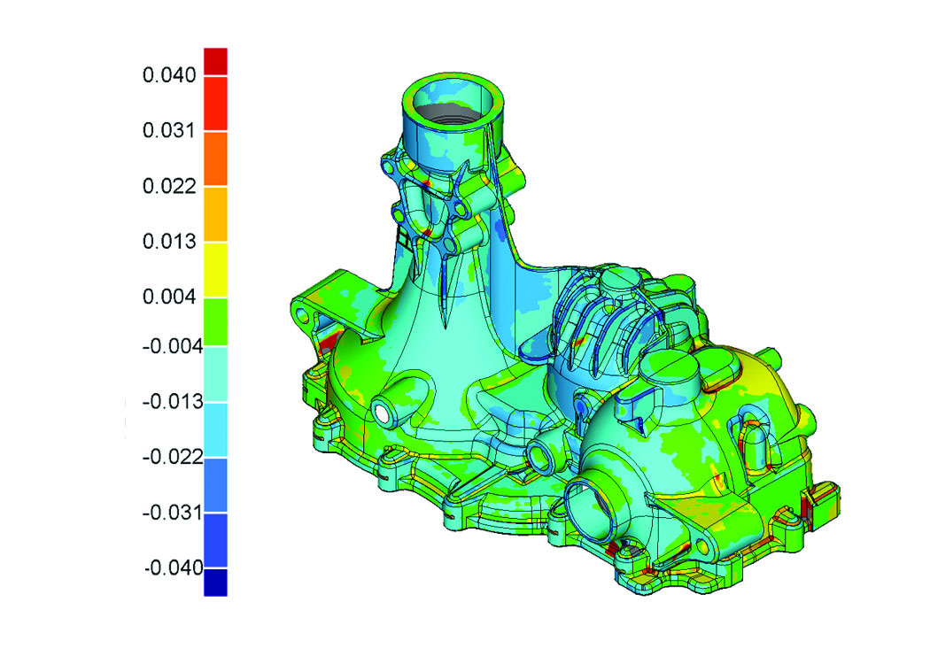
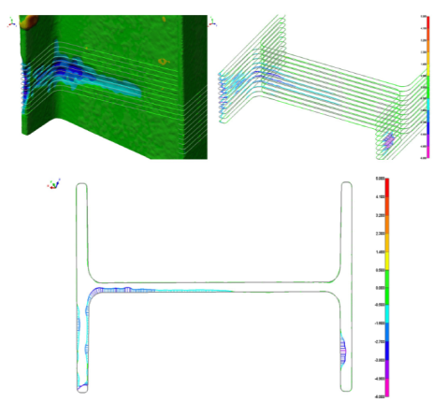
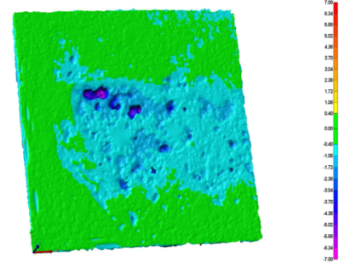
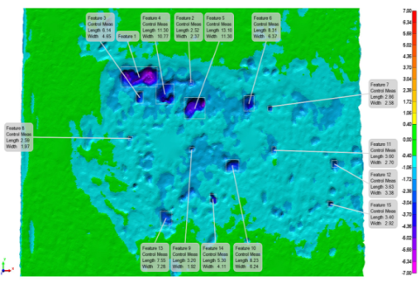
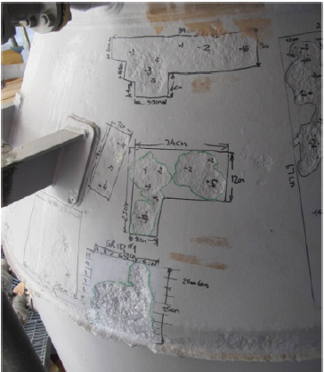
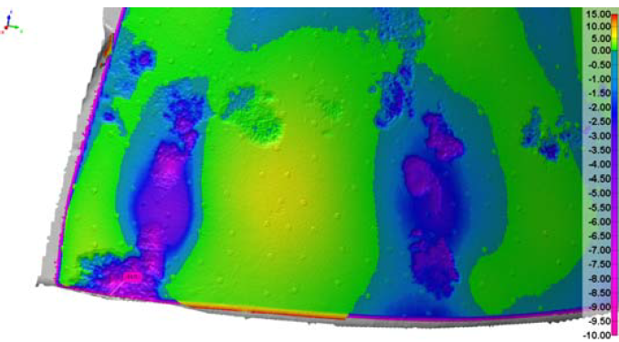
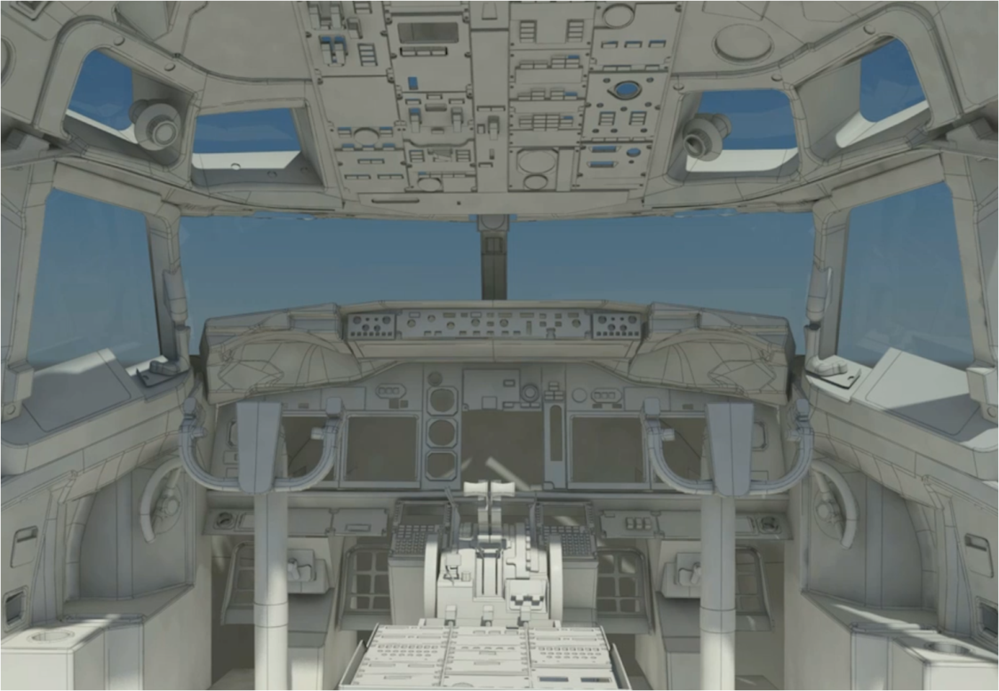
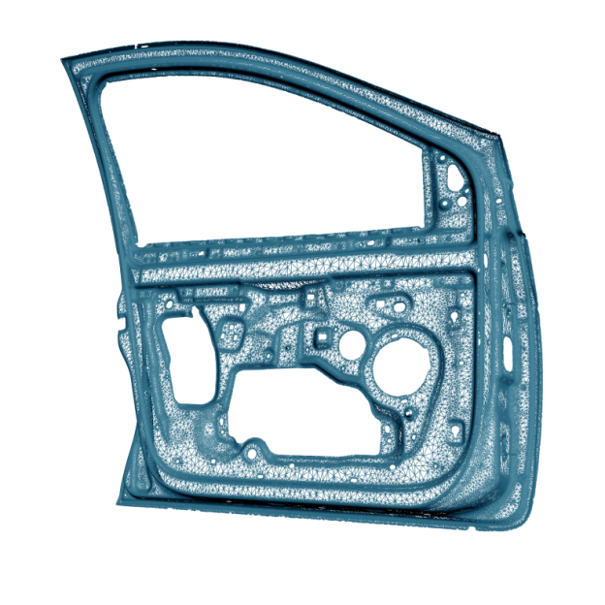
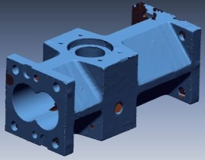
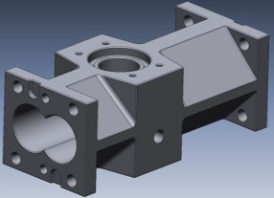
Other applications
Quality Control:
Reverse engineering:

Slide 19
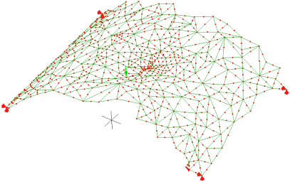
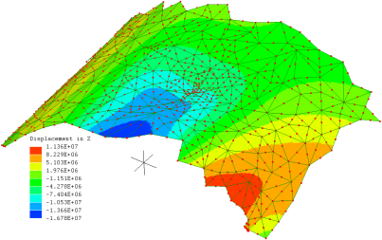
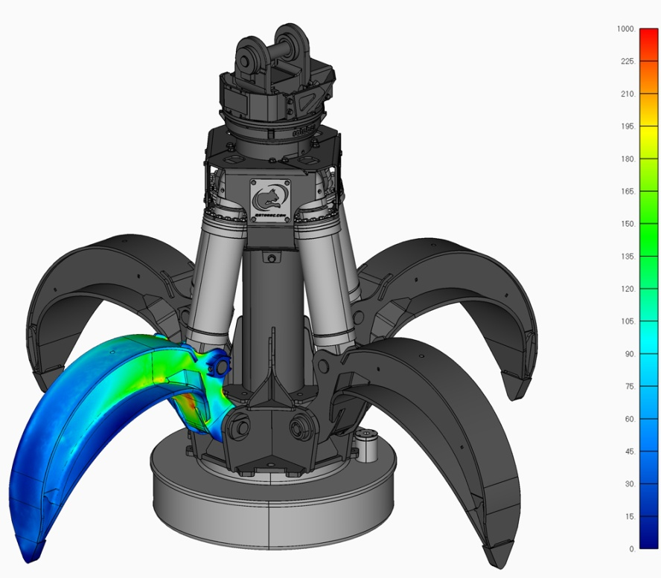
Other applications
Finite Element Analysis
Export directly to FEA programs

Slide 20
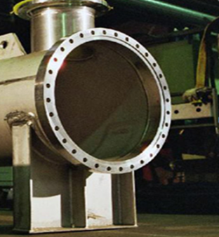
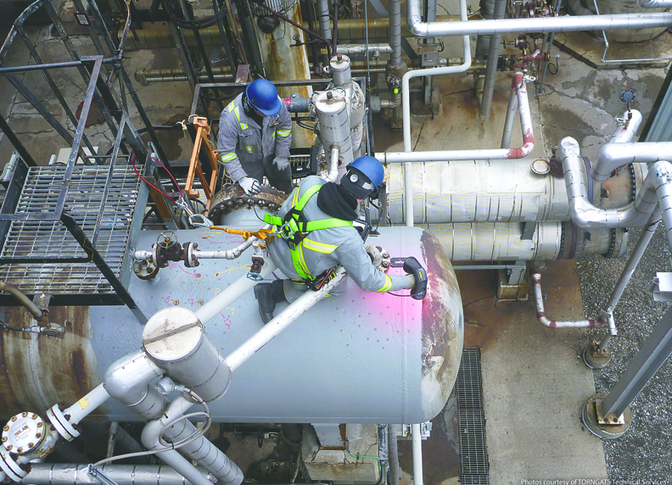
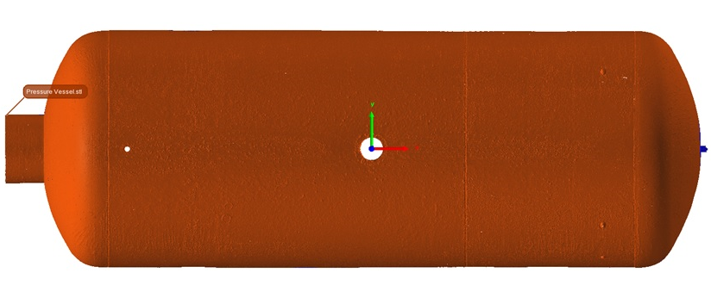
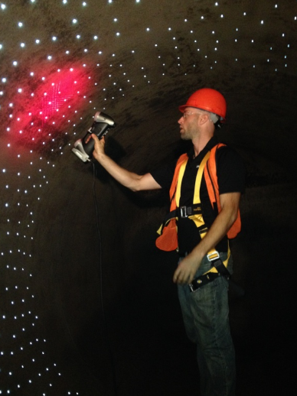
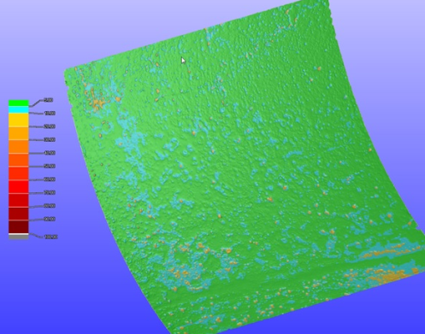
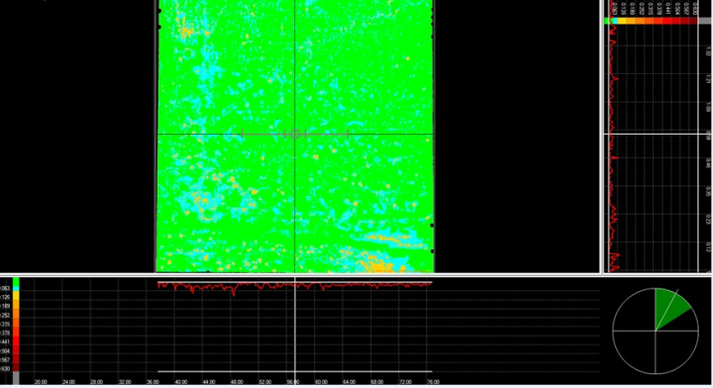
Other applications
Pressure vessel corrosion assessment
Heat exchanger
Rail cars,...

Slide 21
www.creaform3d.com

