Slide 1
Brian MacCracken
KaMac NDT Associates
A Manufacturers Rep Co. and NDT Tech Consultant
In Situ Portable FPI System

Slide 2
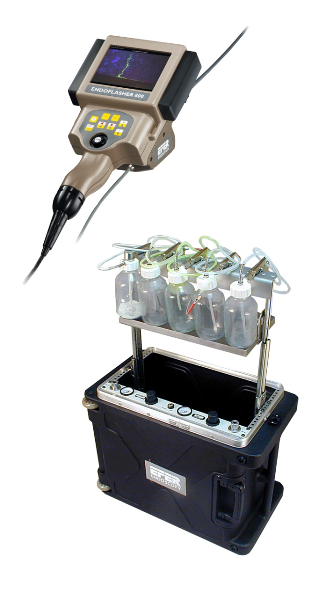
IN SITU PORTABLE FPI SYSTEM

Slide 3
IN SITU PORTABLE FPI SYSTEM

Slide 4
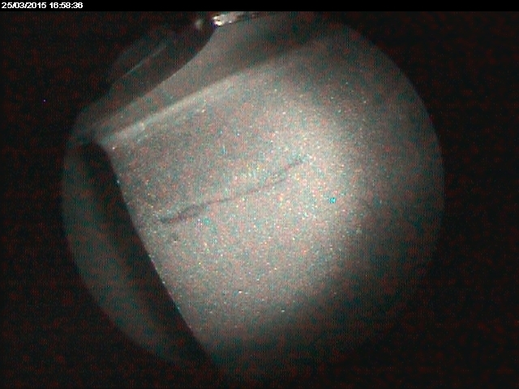
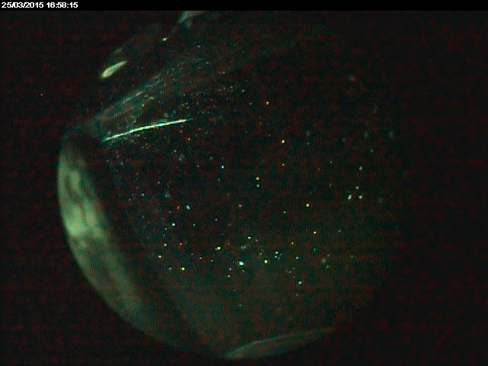
Portable Endoscopic FPI System
Insitu Compressor Blade inspection
Examination: Standard Endoscopy shows indication on blade airfoil surface
Evaluation After FPI: FPI Endoscopy determines that;
the indication is false
2) a previously non-visible defect (crack) exists in airfoil filet radius to blade platform
Standard Endoscopy
FPI Endoscopy
Real defect !
False indication

Slide 5
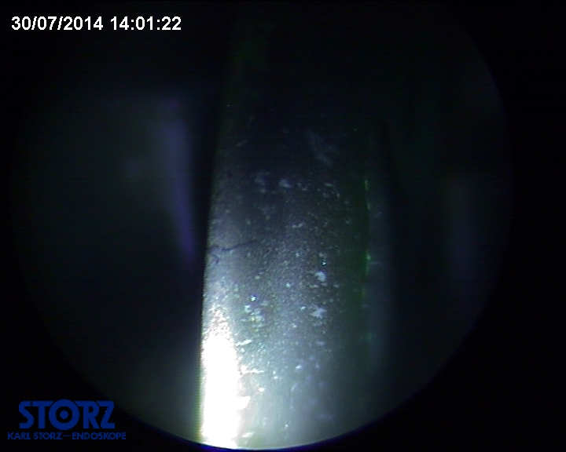
Example of false positive identified during borescope check
Indication appearing as a crack.

Slide 6
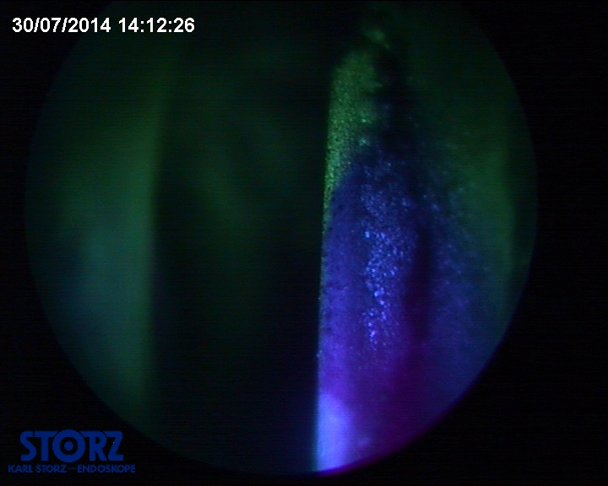
Example of false positive identified during borescope check contd.
ENDOFPI confirms false indication

Slide 7
Example of crack suspicion during borescope check
Particularly difficult to interpret under white light (multiple marks, scratches...)

Slide 8
Example of crack suspicion during borescope check contd.
Portable Endoscopic FPI inspection reveals actual cracks in the blade

Slide 9
IN SITU PORTABLE FPI SYSTEM
This innovative portable FPI system allows you to:
Resolve doubts from a routine in situ borescope inspection posed by indications
Guarantee material health after blending
Limit engine disassemblies
Contribute to flight safety
Lower engine operation costs

